Slide 1


Ramzy 3ada wane 3la elma5da

Slide 2

Khaild
Mostafa Ashraf
Youssef Rayhan
Ahmed Ramzy
Wafaa Gamal
Marwa
Under Supervision Of:
DR: Asmaa Saad && ENG: Juma El Mokhtar

Slide 3
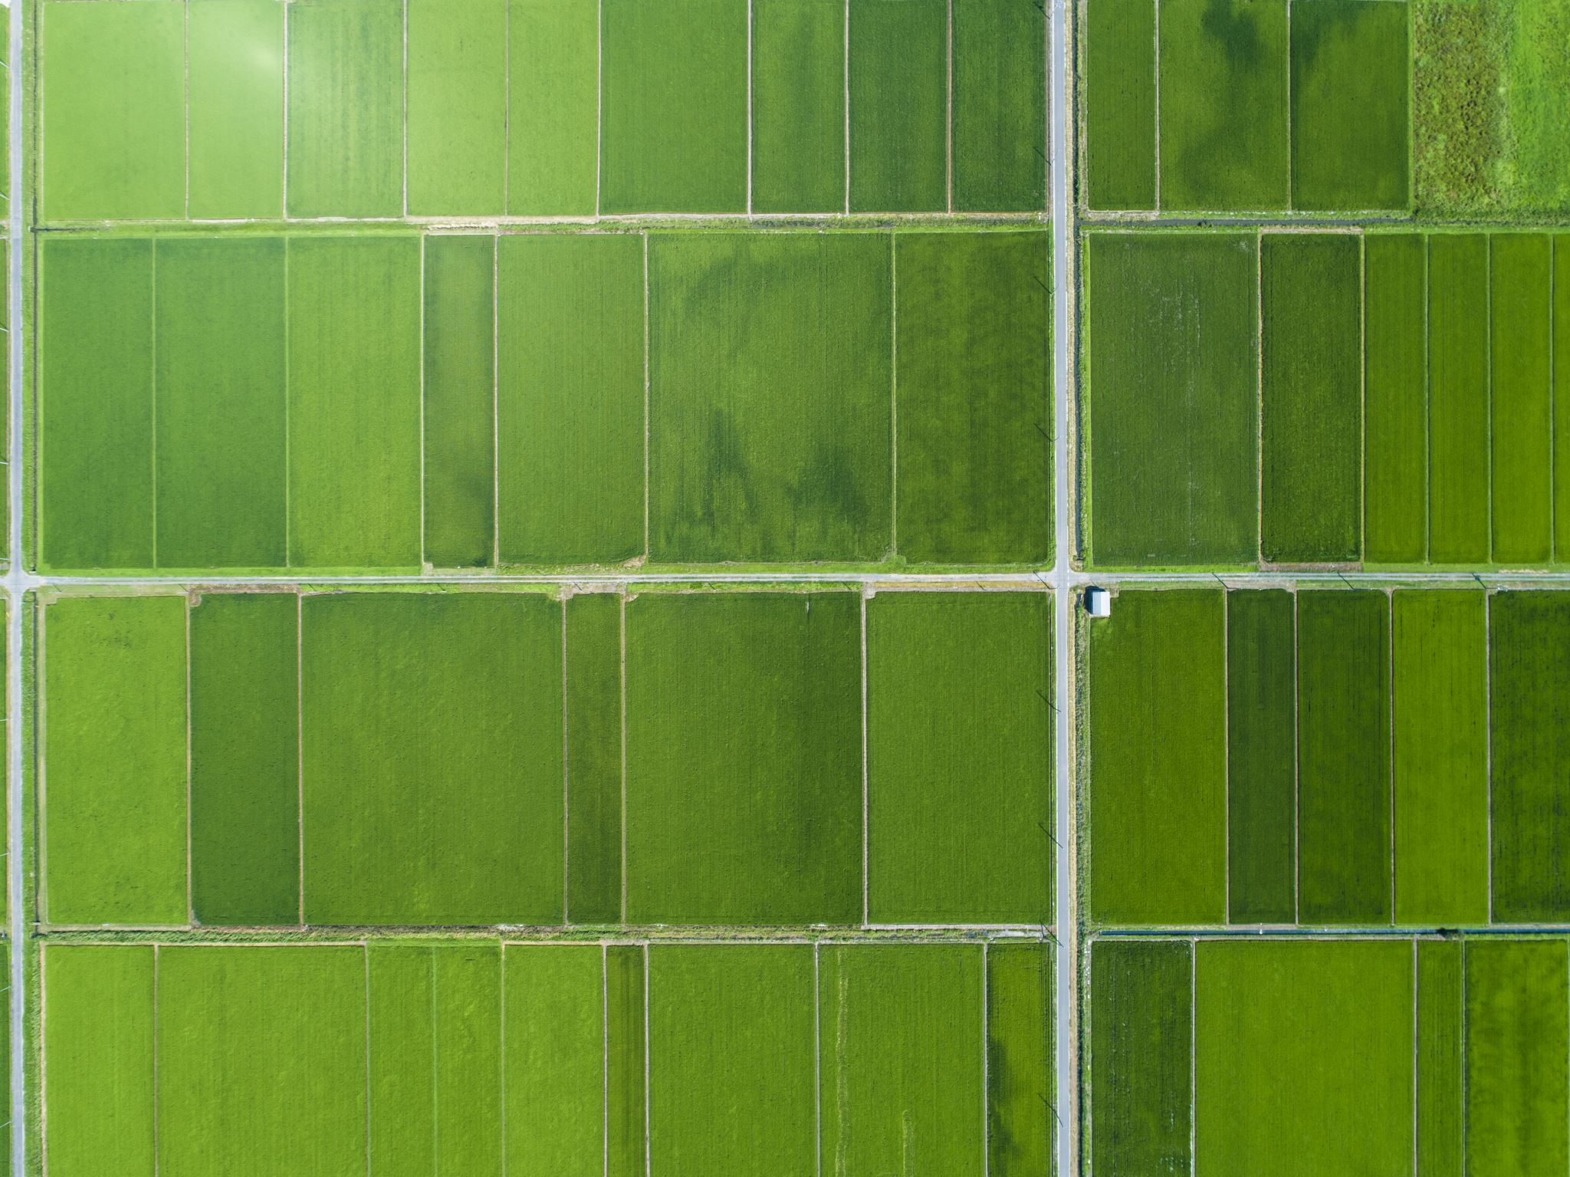
Smart agricultural management platform

Slide 4
AGENDA
Introduction
Problem Statement
Aims and Objectives
Proposed Solution
Project Plan
GANTT Chart
Risk Management
Functional and Non-Functional Requirements
Diagrams

Slide 5

Introduction
The agricultural sector is one of the fundamental pillars of the Egyptian economy, serving as a primary source for food supply, job creation, and achieving food security. The importance of agriculture in Egypt spans across history, starting from the Pharaonic civilization, which relied on the Nile River and agriculture as a foundation for economic and social growth, to the present day, where the agricultural sector significantly contributes to the national GDP. However, the agricultural sector in Egypt faces major challenges that impact its efficiency and sustainability.

Slide 6

Problem Statement
Farmers face significant challenges, including inefficient resource management, unpredictable weather conditions, pest infestations, and a lack of real-time data to guide decision-making. Traditional farming methods often result in wasted resources, reduced yields, and environmental harm, while climate change intensifies these risks with unpredictable weather patterns. To address these issues, there is a pressing need for a smart agricultural management platform that leverages IoT devices, AI, and weather analytics to provide real-time insights, predictive alerts, and actionable recommendations, enabling farmers to optimize resource use, enhance productivity, and adopt sustainable farming practices.

Slide 7
Aims and Objectives
Aims:
To develop an intelligent agricultural management platform that empowers farmers and agricultural businesses to optimize resource usage, enhance productivity, and adopt sustainable farming practices through real-time data insights, predictive analytics, and AI-driven recommendations.
Objectives:
Real-Time Monitoring and Optimization: Use IoT devices and AI to track soil conditions, crop health, and resource usage, providing actionable insights to optimize water, fertilizers, and pest control.
Predictive Alerts and Recommendations: Integrate weather data and AI-driven recommendations to proactively address risks and improve productivity with tailored suggestions.
User-Friendly, Scalable Solutions: Provide an intuitive dashboard for decision-making and scalable tools that cater to both individual farmers and large agricultural businesses, promoting sustainability.

Slide 8
Proposed Solution
The proposed solution is a smart agricultural management platform that leverages IoT devices, AI, and weather analytics to address key farming challenges. The platform enables real-time monitoring of soil, crop health, and environmental conditions through IoT sensors, while AI-driven analytics provide tailored recommendations for irrigation, fertilization, and pest control. It integrates predictive alerts based on weather forecasts to help farmers proactively mitigate risks such as extreme weather or infestations. With tools to optimize resource usage and promote sustainable practices, the platform offers a user-friendly dashboard accessible across devices, catering to both small-scale farmers and large agricultural enterprises. This solution empowers farmers to enhance productivity, reduce costs, and adopt eco-friendly farming methods.

Slide 9

Project Plan
Research & Analysis (1-2 Months): Identify farmers' needs and define features.
Design & Prototyping (2-3 Months): Create wireframes, architecture, and a clickable prototype.
Development (4-6 Months): Build backend (APIs, database), frontend (UI, data visualization), and AI modules.
Testing (2 Months): Test IoT integration, functionality, and user acceptance.
Deployment (1 Month): Launch platform on cloud and app stores with training.
Maintenance (Ongoing): Provide support, gather feedback, and update regularly.
Timeline: 10-14 months Milestones: Design, IoT integration, AI deployment, prototype, full launch.

